Slide 1
Actio: An OSS Anti-Financial Crime and Risk Management Solution
PI 17 Review
2022-04-27

Slide 2

Actio FCRMS - MVP Journey
Mojaloop PI 12
Mojaloop PI 13
Mojaloop PI 14
Mojaloop PI 15
Mojaloop PI 16
Mojaloop PI 17
Actio PI 1 - PoC
Actio PI 2
Actio PI 3
Actio PI 4
Actio PI 5
Actio PI 6
The FCRMS workstream, through a partnership between Sybrin and LexTego, conducted a technology Proof of Concept to compose a fraud risk management solution exclusively out of Open Source Software (OSS) components and achieved:
Peak through-put exceeding 8000TPS
Turn-around time of less than 35ms
Utilising 5 sample typologies representing:
SIM Swap Fraud
Scams
Account Muling
Money-Laundering (Layering)
Block-list management and interdiction
The focus of this PI was to finalise the MVP solution component selection and architectural design.
Deliverables in this PI included:
Implementation of ArangoDB for multi-modal DB support, including graph processing
Implementation of a Mojaloop instance for testing and integration
Implementation of a CI/CD pipeline
Development of a Predicate Builder to facilitate typology development and scoring
Construct an end-to-end flow utilising implemented components
The focus of this PI was to extend the platform with additional components and functionality, specifically:
The implementation of a Payment Platform Adapter to convert Mojaloop messages to ISO 20022-compliant messages
Implementation of ISO 20022-compliant data flows inside Actio
Data protection by design - Pseudonymisation of customer information in NiFi
Configuration-driven rule and typology processing
During this PI we focused on security hardening of the platform and optimisation of the ISO20022 messages.
Completed end-to-end flow
Addressed several pre-existing vulnerabilities that exposed Actio to a MOZI botnet infection
Standardised the translation of ISO20022 from XML to a compact JSON format
Replaced the gRPC inter-service communication protocol with HTTP in support of OpenFaaS
Enhanced automated testing to include exhaustive functional testing capability
Our focus for PI5 was to add the “content” for the platform, which involved the additional ISO messages as well as building rules and typologies.
End-to-End implementation of 4 ISO 20022 messages
Implementation of 2 typologies
Implementation of 9 rules
Closing of some gaps in the end-to-end flow
Our focus for PI6 was to add the “content” for the platform, which involved completing the development of rules and typologies.
Implementation of 35 rules
Implementation of 31 typologies
Entity resolution
Performance tweaks

Slide 3
Actio
Actio is an Open Source real-time transaction monitoring platform that can ingest transaction messages in ISO20022 format and evaluate transactions for fraud and money-laundering behaviour using 35 pre-configured rules that support 31 pre-defined typologies.

Slide 4
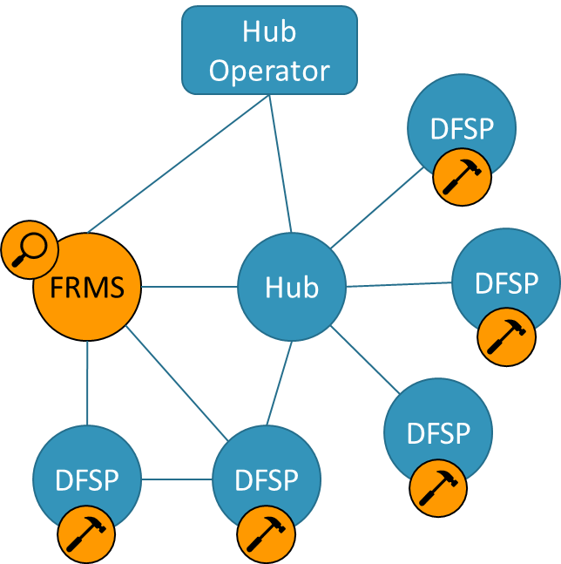
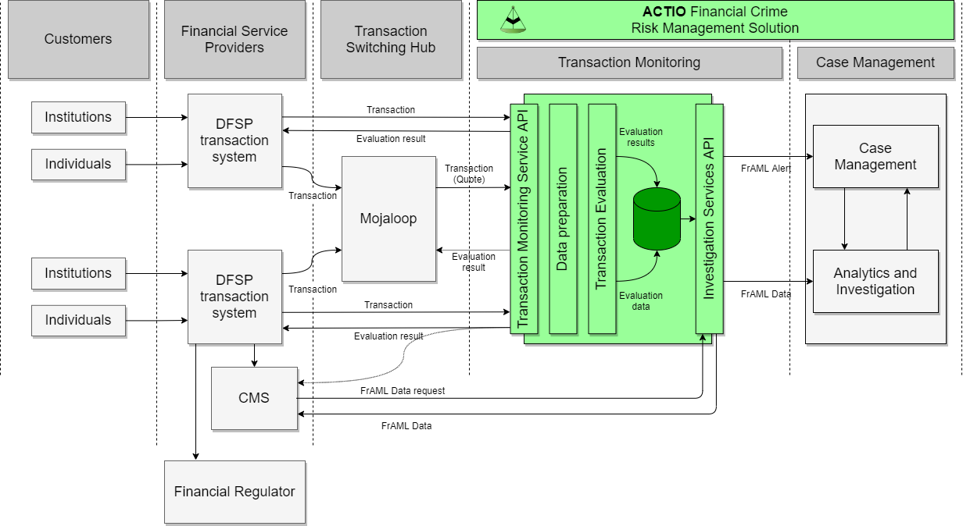
Actio context
Semi-attached
Centralised financial crime risk detection service hosted by the switch Operator
Separate interface to receive transactions from switch participants and non-participants
The Operator performs detection on all transactions routed to the FRM service
Each DFSP would employ compliance teams
Notes:
Mojaloop does not intend to interdict a transaction, but a direct route to a DFSP can be provided that can interdict, and faster.
Architecture primarily focused on Mojaloop scale, but needs to cope with a small DFSP as well.
Data related to the transaction that is required for transaction monitoring is assumed to be supplied within the hub transaction messages.
Data that is not available in the hub transaction message, we have architected and tested the ability to collect additional required information from other sources, including the payer and payee DFSPs.

Slide 5
Actio Process Flow
Aggregate rule results
Calculate a typology score based on rule results and typology configuration
Interdict transaction (optional)
Create investigation alert
Route typology result to the Channel Aggregation and Decisioning Processor
Receive ISO 20022 compliant transaction message
Validate message contents
Route message to NiFi for data preparation
Receive ISO 20022 compliant transaction message
Determine appropriate typologies
Determine associated rules
Route transaction message to rule processors
Aggregate channel results
Create investigation alert
Write transaction results
PPA
TMS
API
Data
Prep
CRSP
RULES
TP
CAD
Proc
TAD
Proc
CMS
Receive Mojaloop transaction message
Transform Mojaloop message to ISO 20022
Enrich later messages from earlier messages
Submit transaction message to Actio TMS API
Resolve transaction participants into unique entities
Pseudonymise personal identifying information
Enrich transaction (optional)
Write message history
Update transaction network graph
Route to Channel Router & Setup Processor
Receive ISO 20022 compliant transaction message
Evaluate transaction according to rule code and configuration
Post rule results to the typology processor
Aggregate typology results
Issue transaction release (optional)
Route channel result to the Transaction Aggregation and Decisioning Processor
Investigate transaction monitoring service alert
Update transaction results

Slide 6
PI 6 Delivery
Typologies (2 existing + 29 new)
Rules (9 existing + 26 new)
Entity resolution
Data model extension
Performance improvements
Whitesource scanning
Deployment automation

Slide 7
ACTIO data model
{entities}
{entities}
Entity
Attributes
Id
CreDtTm
Entity
Attributes
Id
CreDtTm
Pain.001
PmtInf
DbtrAcct
CdtTrfTxInf
Dbtr
Id
PrvtId
Other
MSISDN
ACTIO_EID
Id
PSEUDO
Cdtr
Id
PrvtId
Other
MSISDN
ACTIO_EID
CdtrAcct
Id
PSEUDO
TxTp
CstmrCdtTrfInitn
GrpHdr
MsgId
CreDtTm
Amt
Amt
Ccy
PmtInfId
PmtId
EndToEndId
{account_holder}
{account_holder}
Attributes
CreDtTm
Attributes
CreDtTm
{accounts}
{accounts}
Account
Account
{transactions}
Attributes
TxTp
MsgId
CreDtTm
Amt
Ccy
PmtInfId
EndToEndId
Attributes
Id
Attributes
Id

Slide 8



The typology life-cycle
Develop the rules
Compose the typology
Deploy the typology
Calibration
Development
Configuration
Configuration
Configuration
Typology 28 (Scams)
003@1.1.0 Rule: Account dormancy - creditor
008@1.0.0 Rule: Outgoing transfer similarity - Creditor
010@1.0.0 Rule: Increased account activity - Debtor
011@1.0.0 Rule: Increased account activity - Creditor
016@1.0.0 Rule: Transaction convergence - creditor
018@1.0.0 Rule: Exceptionally large outgoing transfer
021@1.0.0 Rule: A large number of similar transaction amounts - Creditor
025@1.0.0 Rule: Aggregated transaction mirroring
027@1.0.0 Rule: Immediate transaction mirroring
028@1.1.0 Rule: Debtor age
030@1.0.0 Rule: New Creditor transfer
034@1.0.0 Rule: Watch-listed account - Debtor
035@1.0.0 Rule: Watch-listed account - Creditor
036@1.0.0 Rule: Watch-listed party - debtor
037@1.0.0 Rule: Watch-listed party - creditor
048@1.0.0 Rule: Large transaction amount vs history - Debtor
063@1.0.0 Rule: Synthetic data check - Benford's Law - Creditor
Rule
configs
Rule
configs
Typology
config
Typology
config
Network
map
Network
map
Config
Store

Slide 9
DevOps

Slide 10
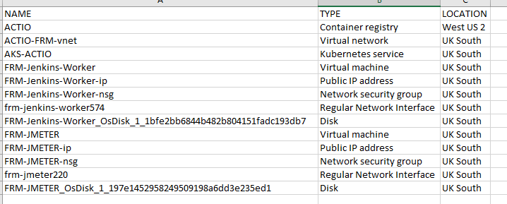
Azure infrastructure breakdown and costing
Costing
To run the current setup will cost an average of
R24 000 ($1527,12)/ R30 000 ($1912,50) per month
Breakdown
The following shows the infrastructure being used be:
Disks - 28
Public IP Addresses - 3
Load balancers - 1
Virtual machine scale set - 2
Virtual Network - 1
Route table - 1
Network security group - 1
Managed Identity - 1

Slide 11
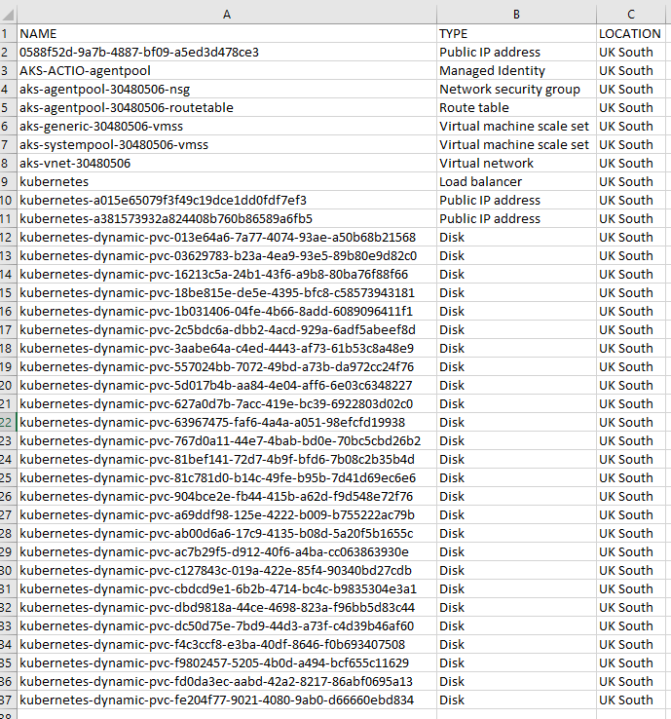

Slide 12
Actio Demo

Slide 13
Actio Performance Demo

Slide 14
Project round-up
3 month PoC + 15 months to build
1060 epics, user stories and tasks
5 SMEs
4 architects
2 DevOps engineers
11 developers

Slide 15
Questions?
Notes:
+21/+31 minutes

